Slide 1
Nabeeh Kandalaft, PhD, P.Eng
Associate Professor in Electrical &Computer Engineering
B.Sc Physics
B.Sc Electrical and Computer Engineering
Iowa State University, Iowa, USA
M.Sc. Electrical and Computer Engineering
Iowa State University, Iowa, USA
Ph.D. Electrical and Computer Engineering
University of Windsor, Ontario, Canada
Office hours: Office hours: T 2:00-4:00 PM
TR 5:00-6:00 PM
W 3:30-5:00 PM
Office: 221 KEN Phone: 331-6018 Email: kandalan@gvsu.edu
Class Blackboard site
Class Syllabus A copy is posted on the class Blackboard site
Additional resources will be posted on the class Blackboard site.
Dr. Nabeeh Kandalaft EGR226 Grand valley State University

Slide 2

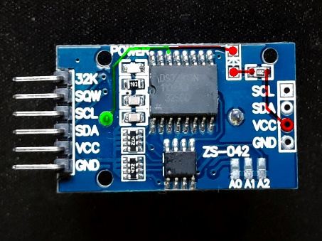
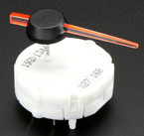
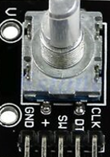
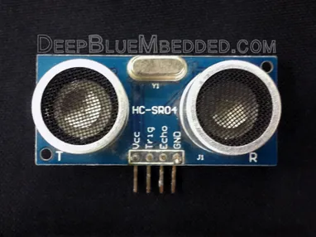
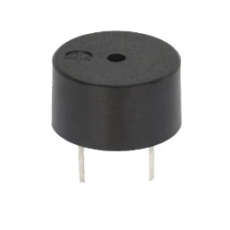
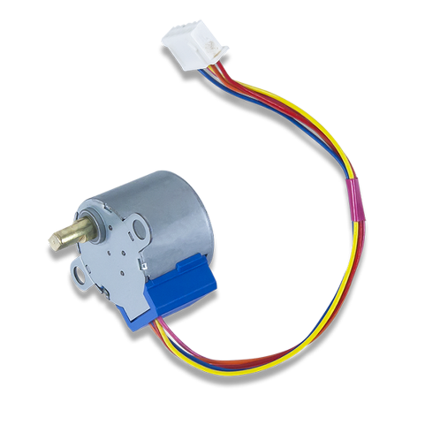
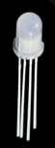
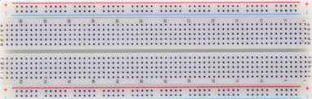
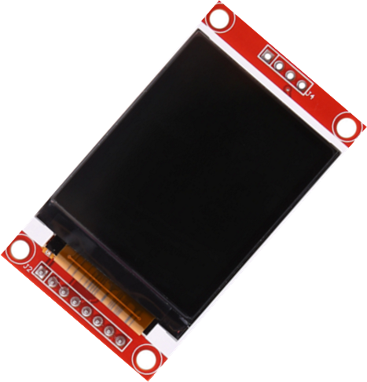
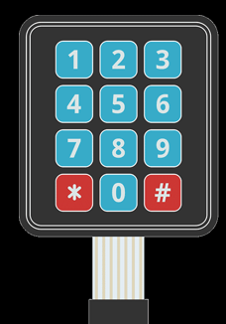
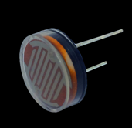
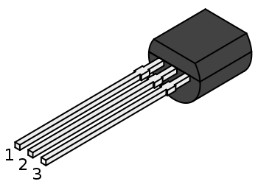
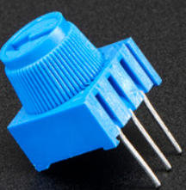
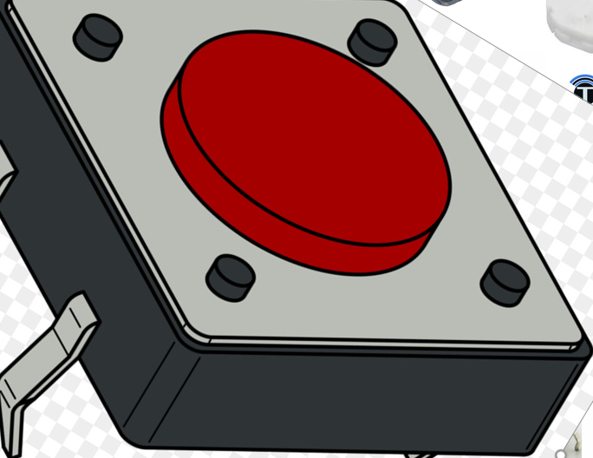
Components in the Lab/Project kit

Slide 3
Additions to 226 kit:
LCD color display ST7735S
RTC module DS3231
Two stepper motor with driver
(switec X27 motor , L293 driver)
(28BYJ-48)
Photo cell 7001
Hall effect transistors OH137
Magnets ??
Lithium battery CR2032
Ultrasonic motion sensor HC-SR204
Rotary Encoder ??
Dr. Nabeeh Kandalaft EGR226 Grand valley State University

Slide 4
Objectives for today’s lecture
After today’s lecture you should be able to:
Describe the major goals of this course
Describe an embedded electronic system and its major components
Give examples of embedded systems
Describe the purpose, goals, and deliverables of the embedded system design project
Dr. Nabeeh Kandalaft EGR226 Grand valley State University

Slide 5
What is an embedded electronic system?
“An embedded system is a microprocessor-based system that is built to control a function or range of functions and is not designed to be programmed by the end user in the same way that a PC is.”
“An embedded system is designed to perform one particular task albeit with choices and different options.”
Heath, Steve. Embedded Systems Design. Jordan Hill, GBR: Newnes, 2002.
“An embedded system is an electronic system that contains at least one controlling device, i.e., the brain, in such a way that it is hidden from the user.”
“The controller is embedded so far in the system that the user usually does not know it exists”
Russell, David. Introduction to Embedded Systems. Morgan & Claypool, 2010.
Dr. Nabeeh Kandalaft EGR226 Grand valley State University

Slide 6
Embedded system architecture
Inputs
Processing and Control
Outputs
analog
sensors
A/D
converter
D/A
converter
analog
actuators
power
supply
display
micro
controller
digital
inputs
digital
actuators
inter-process
communication
timers
memory
Dr. Nabeeh Kandalaft EGR226 Grand valley State University

Slide 7
Embedded Systems
Don’t realize your using them
Cuts product cost- at expenses of complexity
Embedded processors existed before the PC
Most common electronic circuit
Microprocessor or microcontroller?
distinction made by speed, bus bit width, amount of integration
Perhaps the term “embedded processor” is better
Dr. Nabeeh Kandalaft EGR226 Grand valley State University

Slide 8
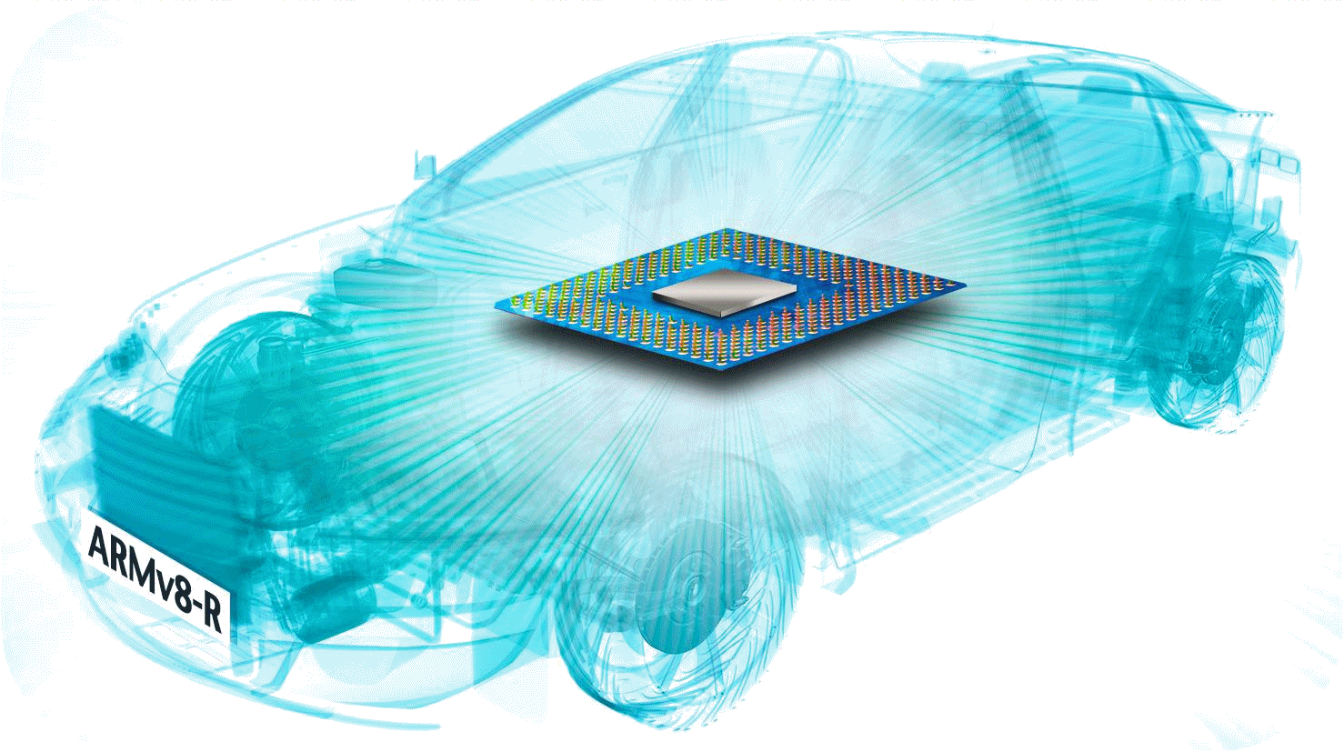
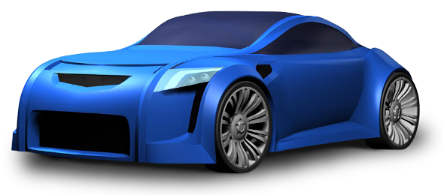
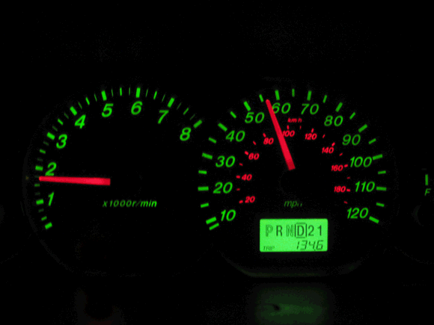
Example of Microcontroller Usage
Modern automobiles employ over 100 embedded processors
Rear Passenger flat panel display
GPS navigation
DVD player
LED lamp cluster
Head-up display
Dashboard cluster
Climate control
Power roof system
Radar sensor
Transmission control
Collision avoidance
HID headlamp
Memory seat
Airbag sensors
Satellite crash sensor
Suspension control
Remote Keyless entry
Adaptive brake lights
Rear view camera
Battery management
Power seats
Parking sensors
Engine control unit
Folding door mirrors
Car radio
Tire pressure
Antilock breaks
Front object laser radar
Nighttime pedestrian
Active steering
Dr. Nabeeh Kandalaft EGR226 Grand valley State University

Slide 9
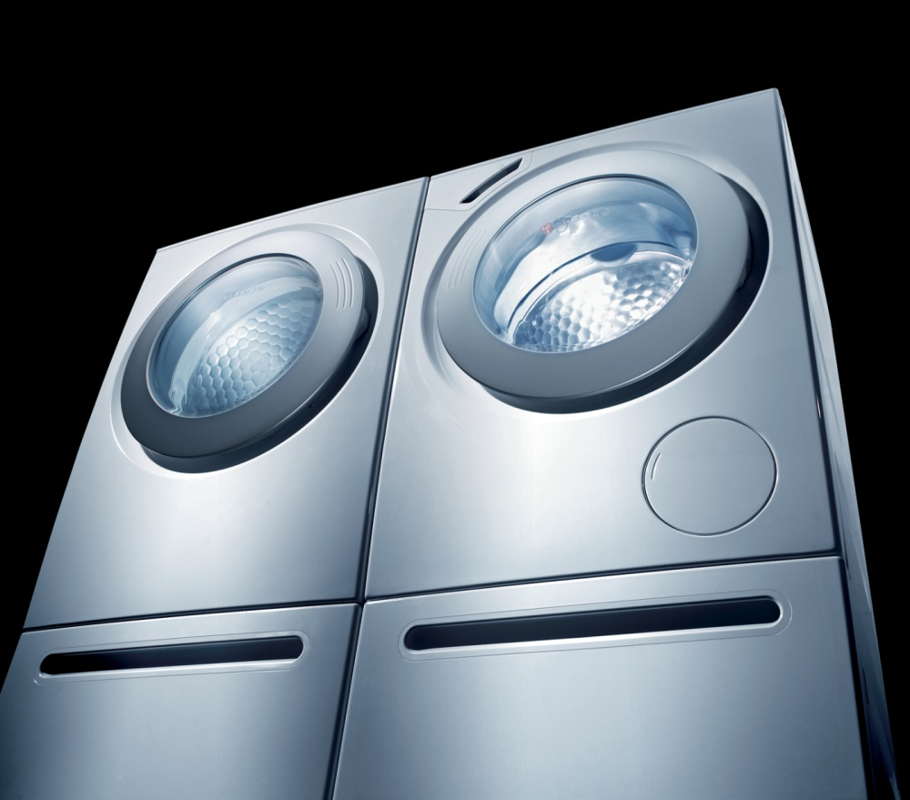
Examples of embedded systems
A washing machine may have a microcontroller that:
contains the different washing programs
provides the power control for the various motors and pumps
controls the display
even notifies the user when the clothes need to go into the dryer
http://www.businesswire.com/portal/site/google/index.jsp?ndmViewId=news_view&newsId=20060718005193&newsLang=en
Dr. Nabeeh Kandalaft EGR226 Grand valley State University

Slide 10
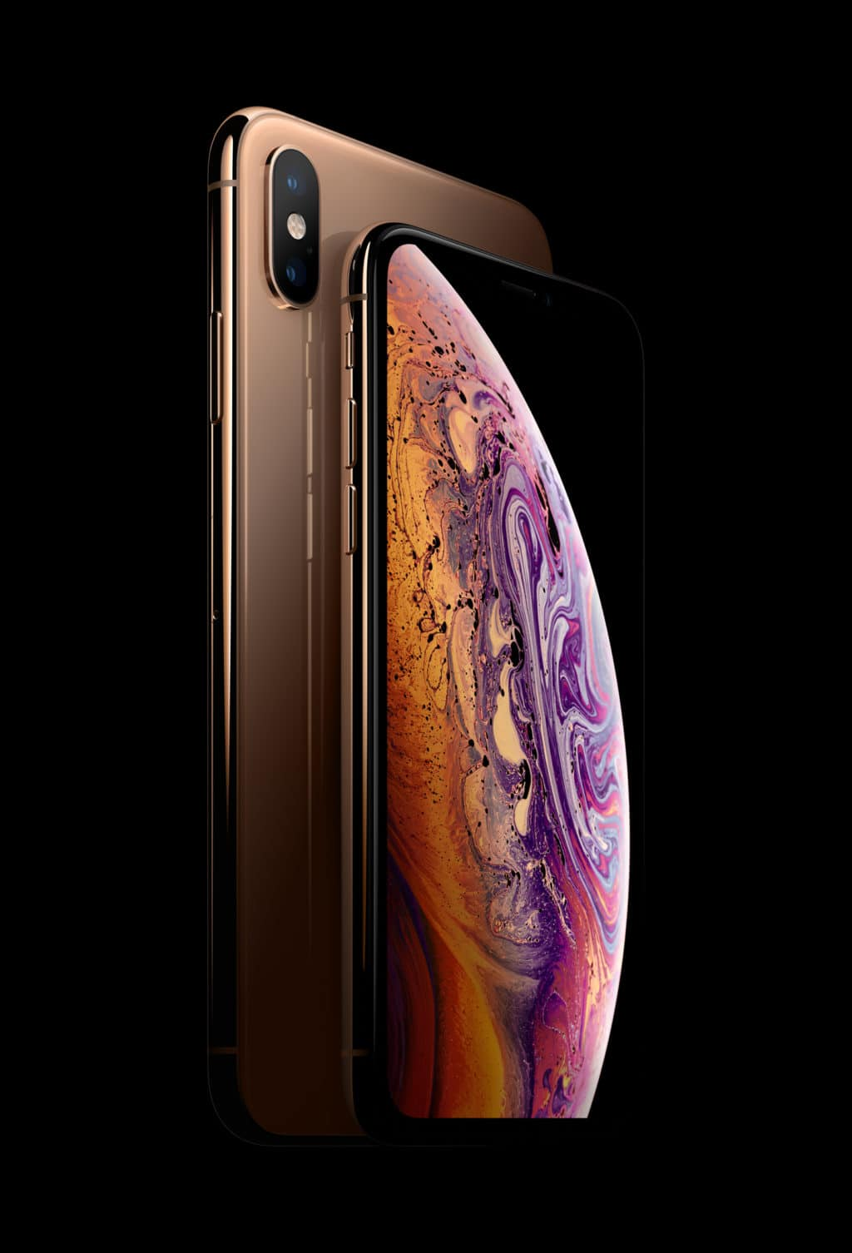
Examples of embedded systems
Smartphone devices such as this Galaxy Note 8 running Android.
Uses the M3 Mongoose (ARM) with integrated quad core CPU at 2.36 GHz Quad Core Cortex A73).
It has 6 GB of RAM and 128 GB of storage.
Sensors: Accelerometer, Barometer, Fingerprint, Gyro, Geomagnetic, Gesture, Heart rate
Dr. Nabeeh Kandalaft EGR226 Grand valley State University

Slide 11
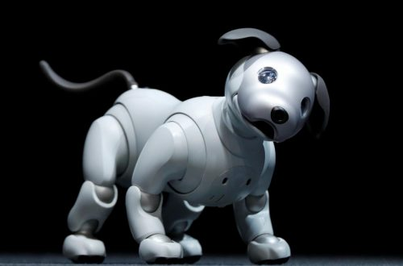
Examples of embedded systems
Sony Aibo dog was developed as a robot pet in Japan.
It was used in Robocup Soccer Team contests.
It contains a 64-bit MIPS processor and Sony’s Aperios Real Time OS.
Dr. Nabeeh Kandalaft EGR226 Grand valley State University

Slide 12
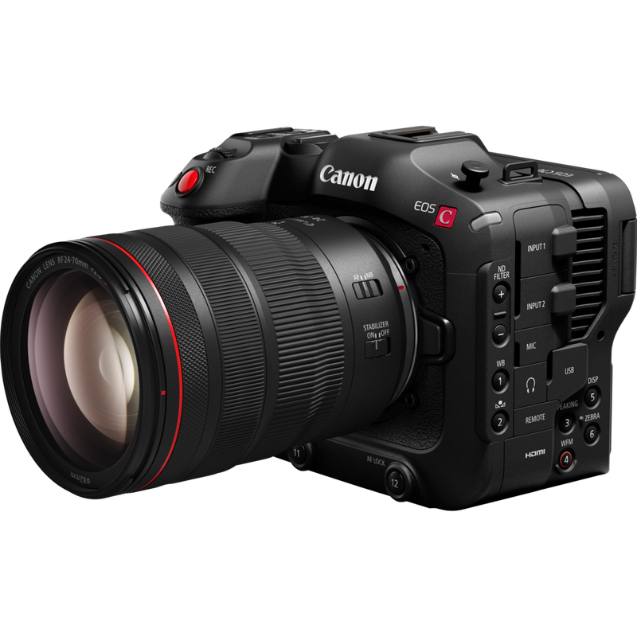
Examples of embedded systems
Digital cameras employ several embedded systems.
They are controlled by an internal microprocessor with image processing capabilities.
Dr. Nabeeh Kandalaft EGR226 Grand valley State University

Slide 13
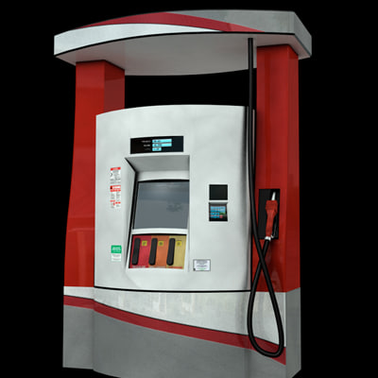
Examples of embedded systems
Most new gasoline pumps employ several embedded systems.
The Dresser Wayne Ovation iX Gas Pump seen here has an ARM processor. It runs the Windows CE OS.
It Displays video ads and is networked to a gas station’s back office computer system to process transactions and place orders.
Remote maintenance features are also provided over the network.
Dr. Nabeeh Kandalaft EGR226 Grand valley State University

Slide 14

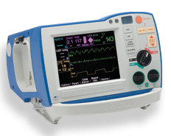
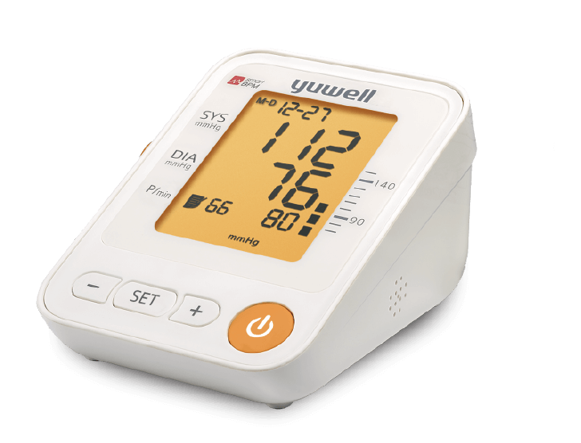
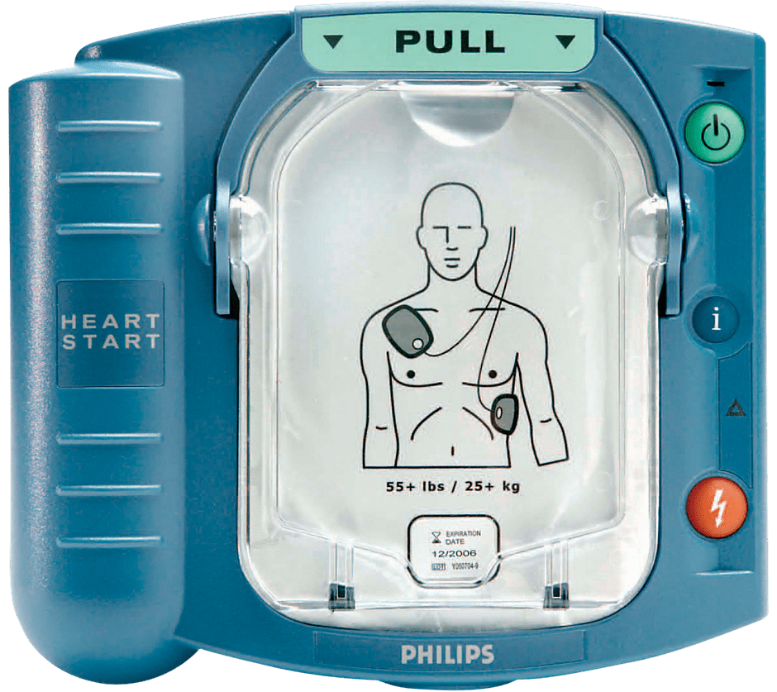
Examples of embedded systems
Many biomedical devices such as this Automatic Defibrillator from Zoll are embedded systems.
This AED also functions as a CPR coach using voice and visual displays.
Biomedical devices have very important safety and liability concerns.
Dr. Nabeeh Kandalaft EGR226 Grand valley State University

Slide 15
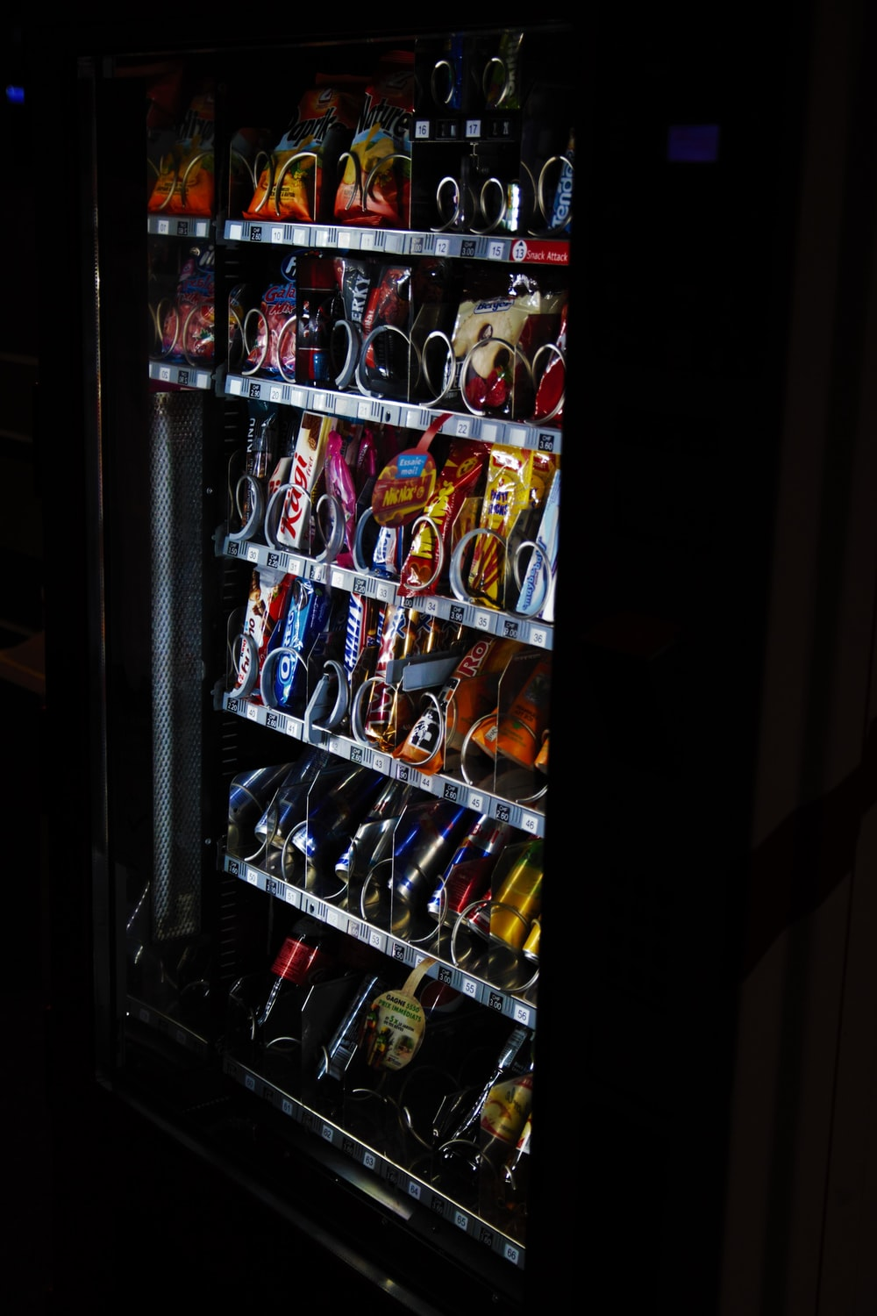
Examples of embedded systems
Most vending machines are embedded systems.
Some new generation vending machines are networked, they can send remote notifications when out of stock or the machine needs service.
Dr. Nabeeh Kandalaft EGR226 Grand valley State University

Slide 16
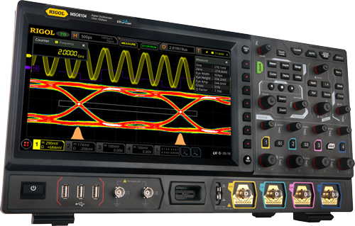
Examples of embedded systems
Most modern Oscilloscopes are actually embedded systems.
High-speed Analog to Digital convertors capture the analog signal and a processor is used to control the device and drive the display.
Dr. Nabeeh Kandalaft EGR226 Grand valley State University

Slide 17
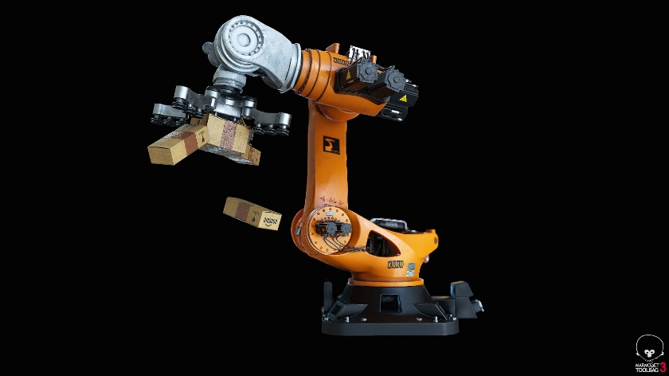
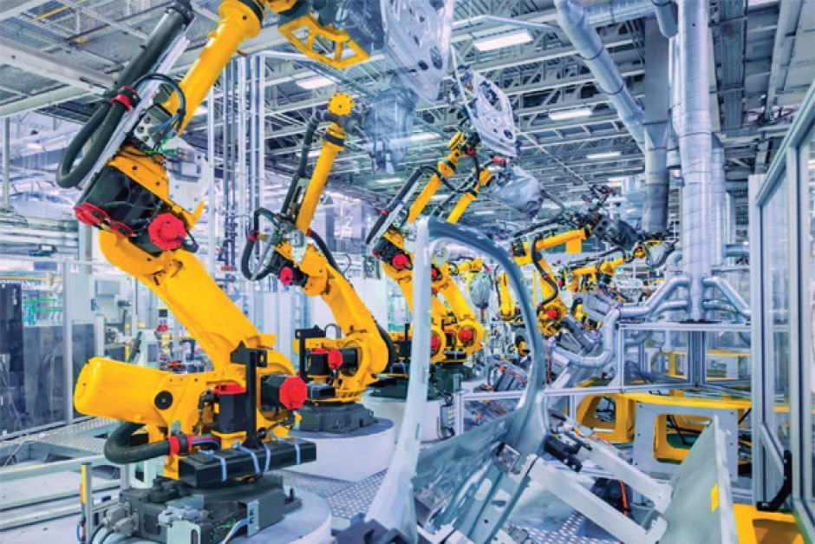
Examples of embedded systems
Industrial robots.
A control computer issues a sequence of operations that are carried out by motors and controllers that are embedded in the robot.
The Kuka robot arms seen here are welding a Mercedes.
Dr. Nabeeh Kandalaft EGR226 Grand valley State University

Slide 18
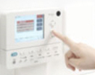
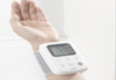
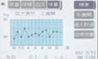
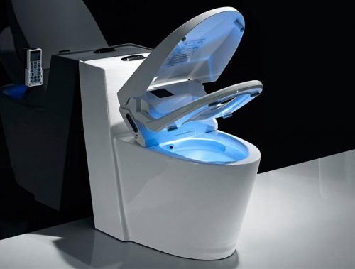
Examples of embedded systems
In Japan, the Toto Intelligence Toilet system will measure urine sugar, blood pressure, body fat and weight on a daily basis.
The data can be transferred over a home network for viewing on your PC.
There is a long history of high-end embedded toilets in Japan.
http://www.mhealthtalk.com/2011/04/smart-toilets-a-royal-flush-for-home-healthcare/
Dr. Nabeeh Kandalaft EGR226 Grand valley State University

Slide 19
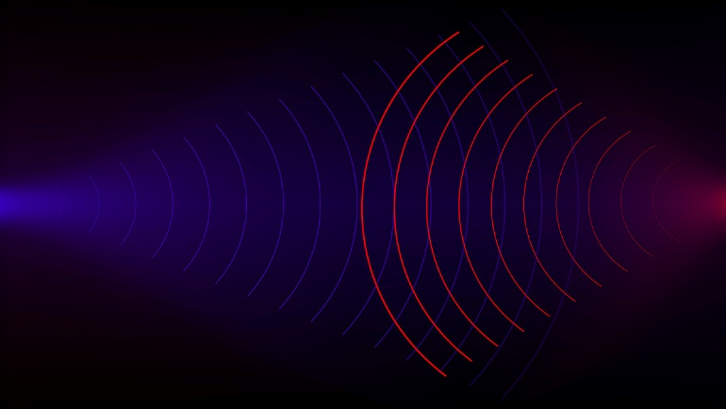
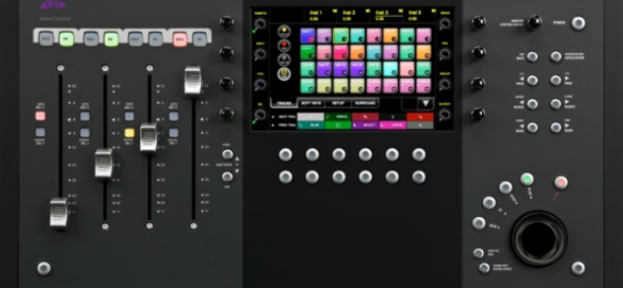
Digital Echo cancellation
Dr. Nabeeh Kandalaft EGR226 Grand valley State University

Slide 20
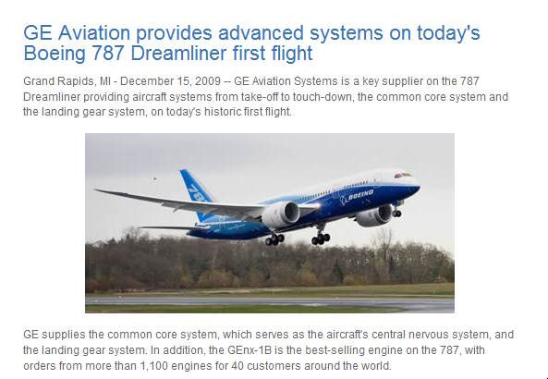
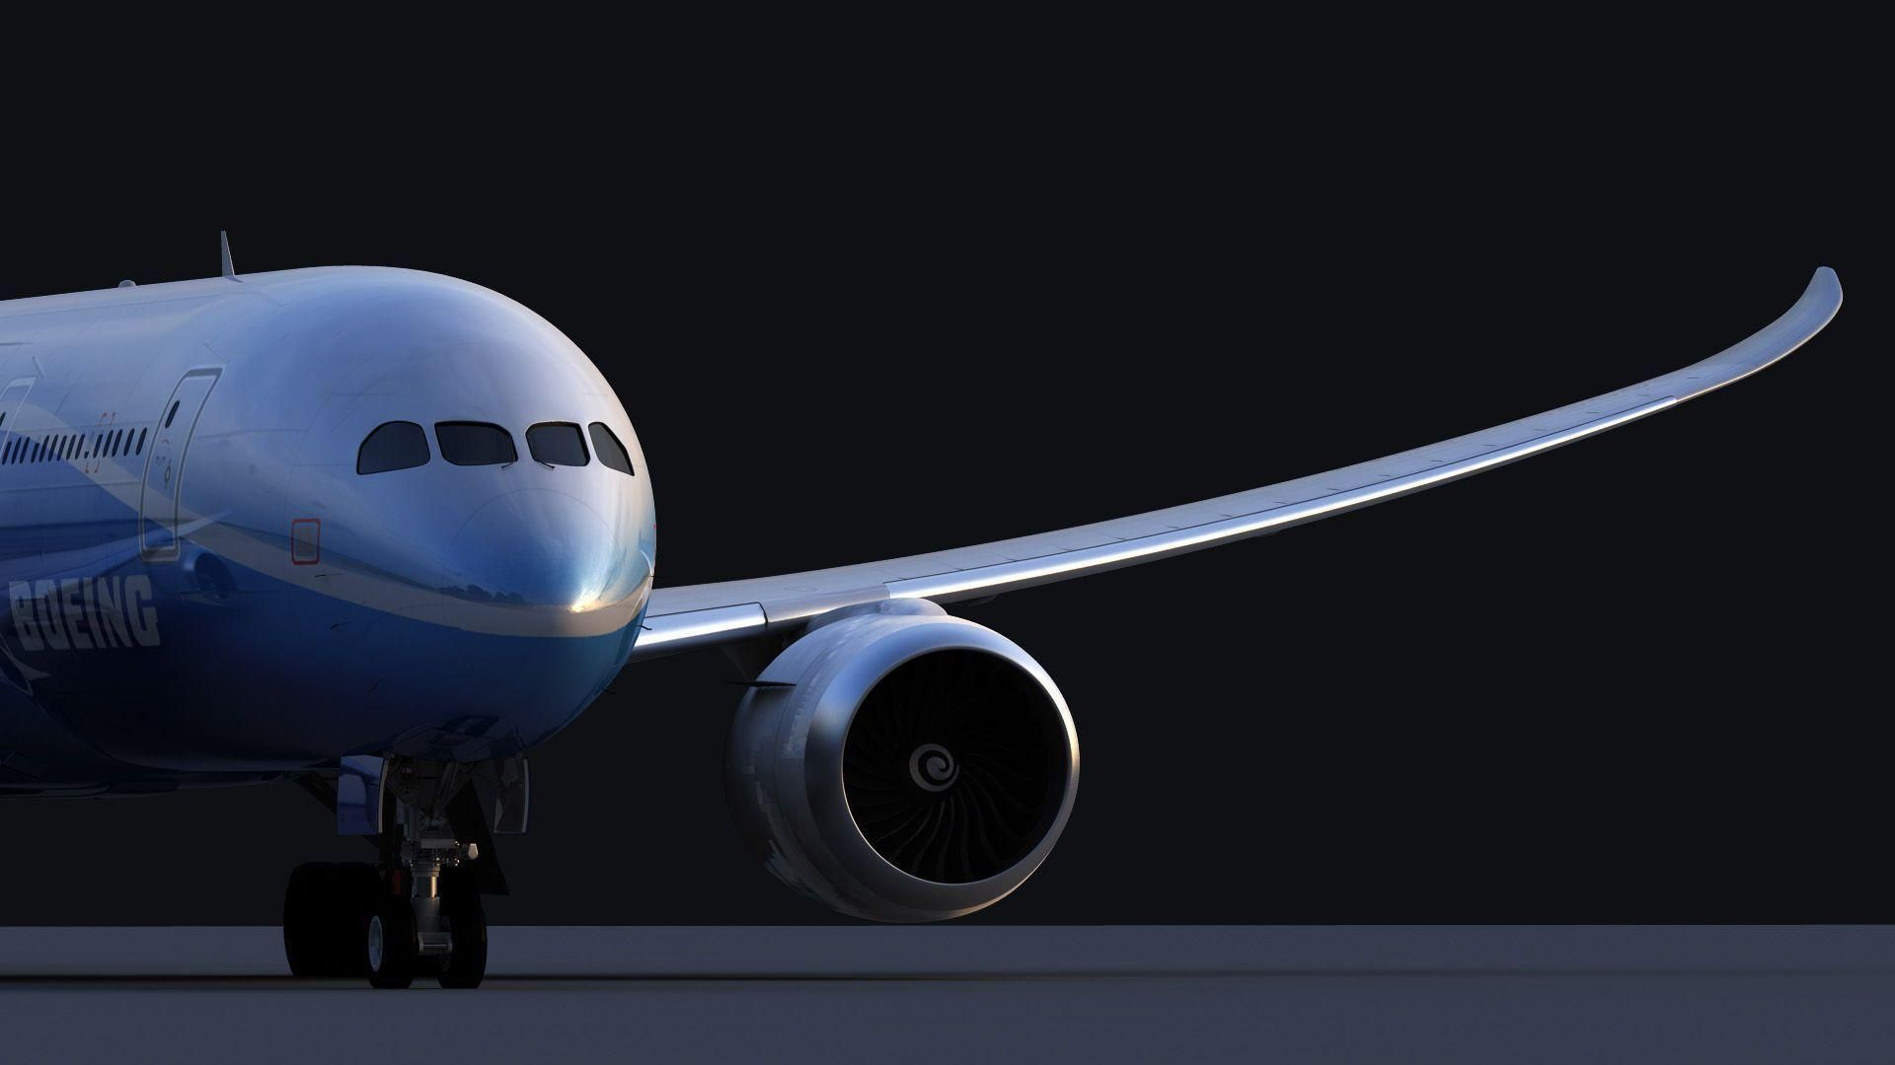
Press release from GE Aviation Systems (in Grand Rapids)
http://www.newairplane.com/787/design_highlights/
Dr. Nabeeh Kandalaft EGR226 Grand valley State University

Slide 21
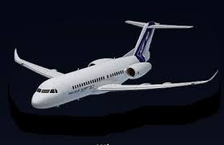
Airbus A350 cargo bay
Dr. Nabeeh Kandalaft EGR226 Grand valley State University

Slide 22
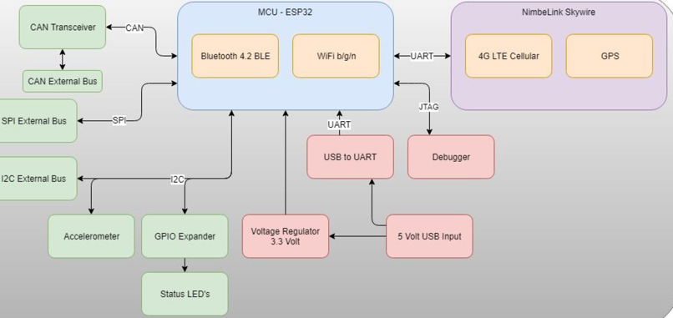
Senior Project Embedded System IoT Rapid Development
Dr. Nabeeh Kandalaft EGR226 Grand valley State University

Slide 23
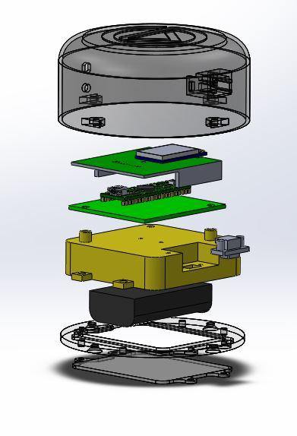
Senior Project Embedded System
This device wakes up to change of status on its sensors.
It has an Atmel 8 bit microcontroller.
It uses a Wi-Fi chip to talk to a router that has an Internet connection.
Sensors for light, temperature, vibration, and sound sense the environment.
A state machine process controls the operation.
Dr. Nabeeh Kandalaft EGR226 Grand valley State University

Slide 24
The Embedded System Design Project
Purpose
apply methods of design presented in lecture
develop skills to manage time, budget
practice documentation, communication skills
prepare for successful senior project
Deliverables
a specifications document based on project functional requirements
a design document that details how it will be built
Verification matrix
weekly progress updates
a working prototype and presentation of the design
Dr. Nabeeh Kandalaft EGR226 Grand valley State University

Slide 25
The Embedded System Design Project
Goal is to design and build an embedded system that:
interfaces with sensors and takes action on data collected
controls an electric motor to perform an action
uses a Serial Peripheral Interface (SPI) and Inter Integrated Circuit (I²C) buses to communicate with multiple peripherals
handles user input from switches and/or keypad
displays user information graphically
employs a real time clock that is maintained by battery
stores information in non-volatile memory
uses a watchdog timer to maintain sanity
uses interrupts to handle multitasking
is powered by a wall socket and converts to DC voltage
serves a useful and interesting function
Dr. Nabeeh Kandalaft EGR226 Grand valley State University

Slide 26
Summary
You should be able to:
describe the major goals of this course
describe an embedded electronic system and its major components
give examples of embedded systems
describe the purpose, goals, and requirements of the embedded system design project
Dr. Nabeeh Kandalaft EGR226 Grand valley State University

Slide 27
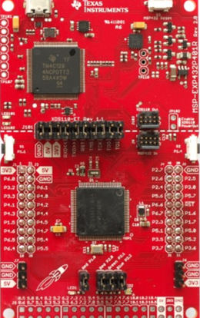
TI MSP432 Launchpad
32-bit, 48MHz Cortex-M4F processor
Memory - 256kB of flash, 64kB of SRAM, and 32KB of ROM preloaded with MSPWare Driver Libraries
Voltage: 1.62V to 3.7V
Current: Less than 1uA while running with RTC, Active is 90uA/MHz
Timers - 4x 16-bit timers, 2x 32-bit timers.
Serial - 4x eUSCI_B modules with I2C/SPI and 4x eUSCI_A modules with UART/SPI/IrDA.
78 (67 available) GPIO - All can generate an Interrupt, all can drive up to 6mA, and 4 of them can drive up to 20mA, 24 of the pins support pin mapping.
Analog - 14-bit 1MSPS ADC with an internal voltage reference and 2 comparators.
Hardware Accelerators for AES and CRC
Built-In DC/DC converter or LDO option reduces operating and sleep current consumption by 40%.
2x buttons + reset button, 1 red LED, and one RGB LED
Dr. Nabeeh Kandalaft EGR226 Grand valley State University

Slide 28
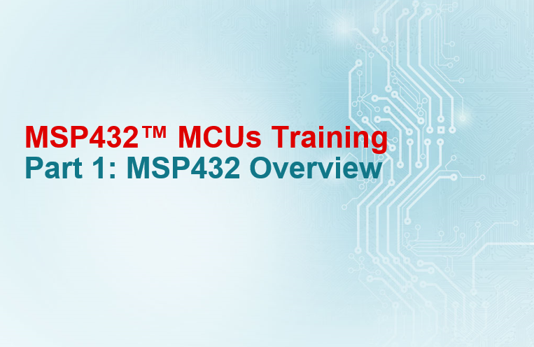
Tutorials Using The TI MSP432
Getting started with the TI MSP432 MCU
https://training.ti.com/msp432%E2%84%A2-low-power-high-performance-mcus-training-series

Slide 29
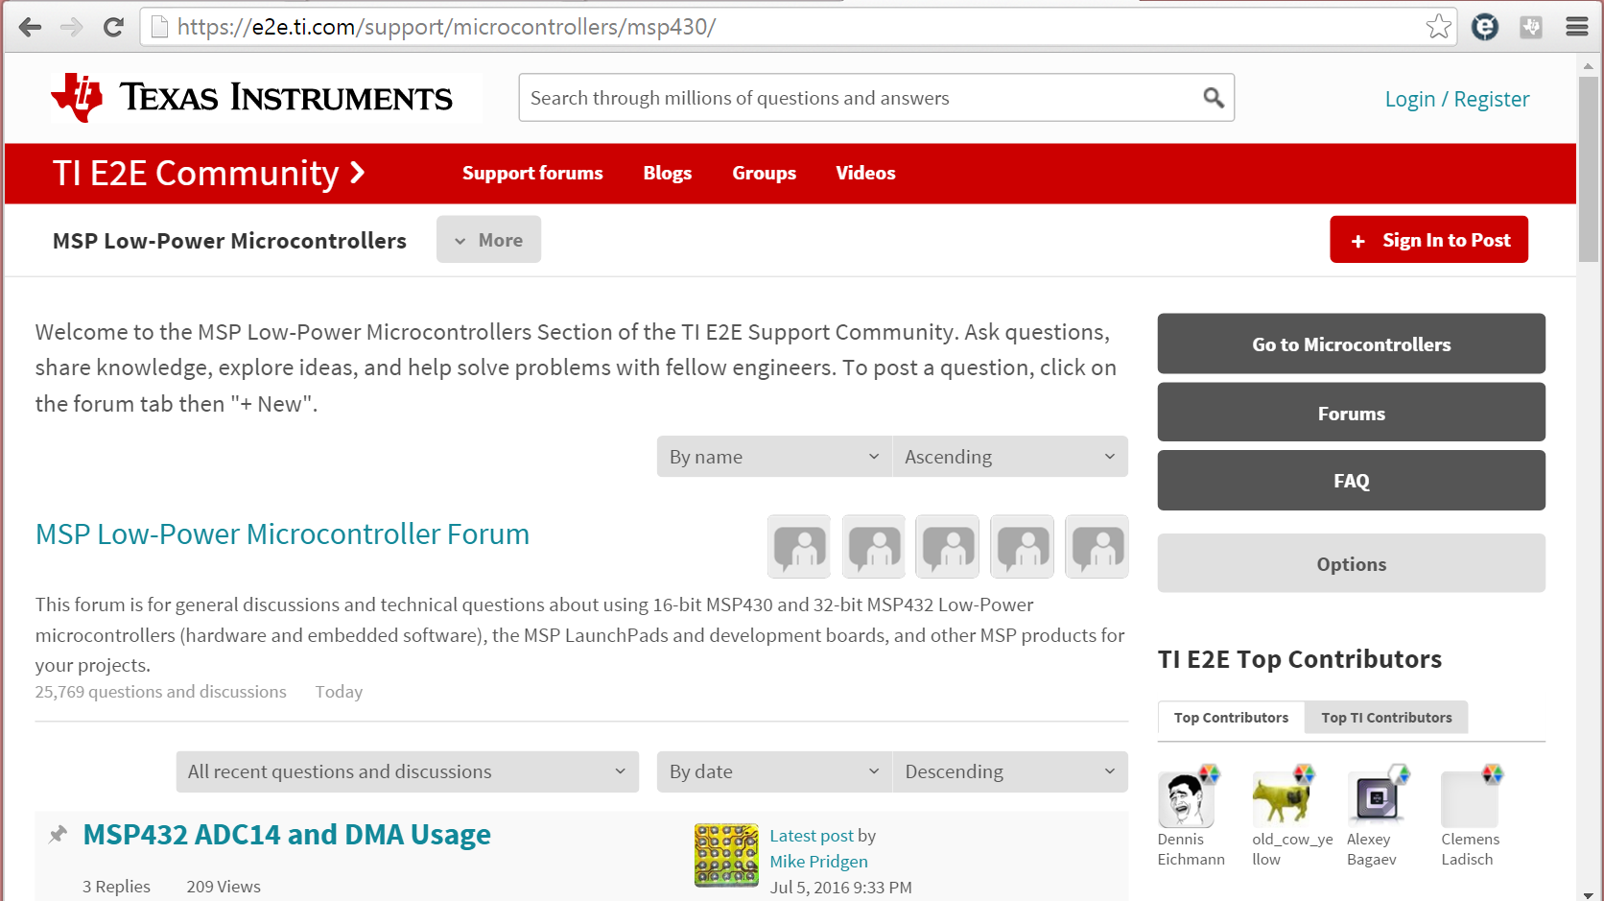
Discussion Forum for MSP Processors and Tools

Slide 30
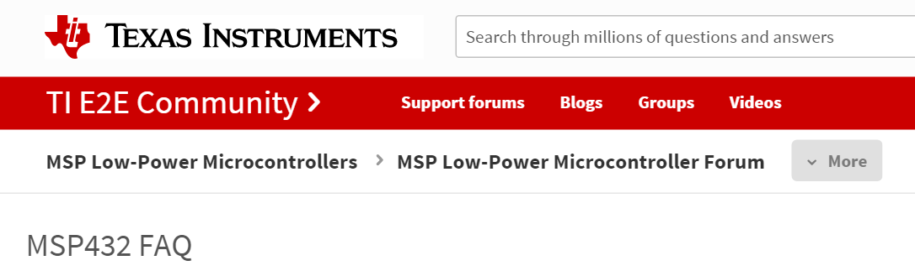
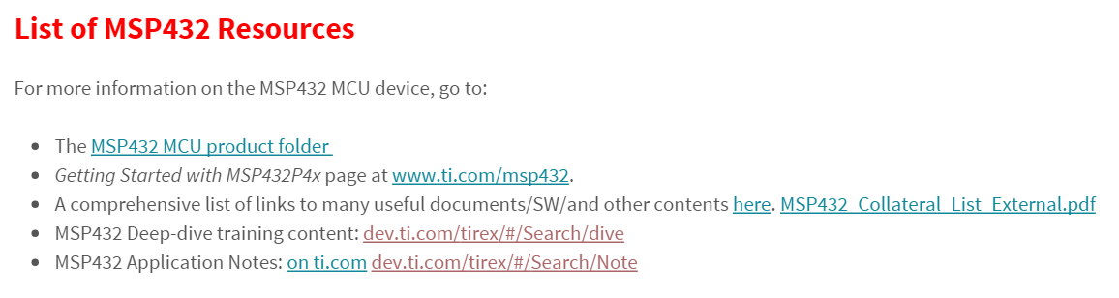
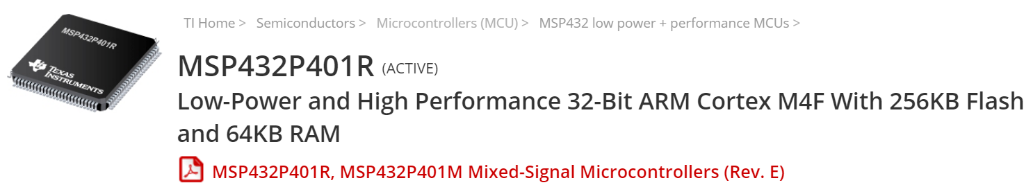
Other TI MSP432 Resources
https://e2e.ti.com/support/microcontrollers/msp430/f/166/t/411030
http://www.ti.com/product/MSP432P401R

